Slide 1
Research Progress Report by:
Soufiane CHAMI
Biomedical Engineering Research Complex (BERC) Laboratory
Estimated hours spent on activities related to:
Research: X hours
Courses: X hours
Others: X hours
From: 21/March/19
To: 27/March/19
1. Introduction
Sepsis early detection ➔ Survival Analysis
Censored Data
Data representation

Slide 2
Censorship in SA
Censorship
https://webfocusinfocenter.informationbuilders.com/wfappent/TLs/TL_rstat/source/Survival45.htm
Notes:
When observing the sample, due to some problems of the observation procedure, there are some censorship in the data.
We observe the samples from the start of the study to the end of the study.
If the event happens during the observation, it will be tracked in the log, that is uncensored data.
If the event would happened after the end of study, we do not know the true event time, that means right censored.
If the event happened before the start of the study, we either do not know the true event time, but it is left censorship.
If the event log is lost during the study, that means interval censored.

Slide 3
2. Survival Analysis (SA)
SA = analyze the expected duration of time until one or more events happen.
Sepsis Data:
  Only the subjects with Sepsis label==1
  Analysis will be Event wise not subject wise
  Only the Vital signs columns + [Age , gender] (11 columns)
Target columns :
  Binary columns to indicate the occurrence of the event
  Time to event columns
Algorithms: Survival Random Forest, RNN, …

Slide 4
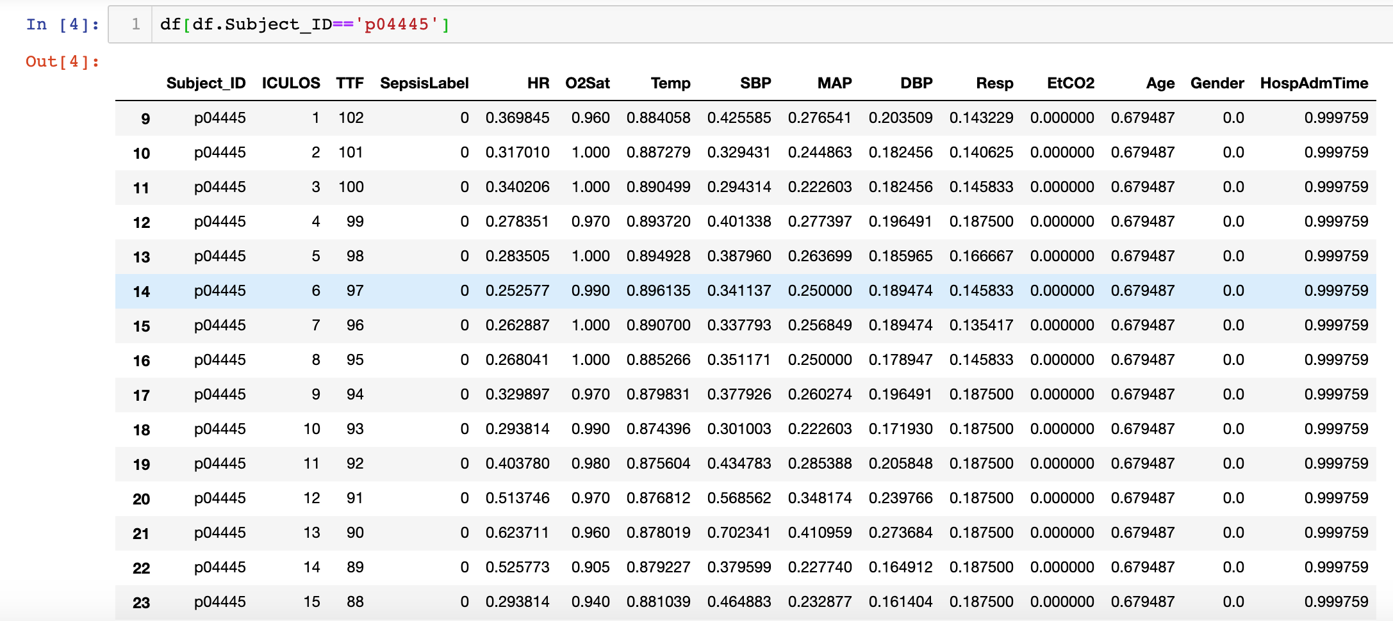

Slide 5
